Slide 1

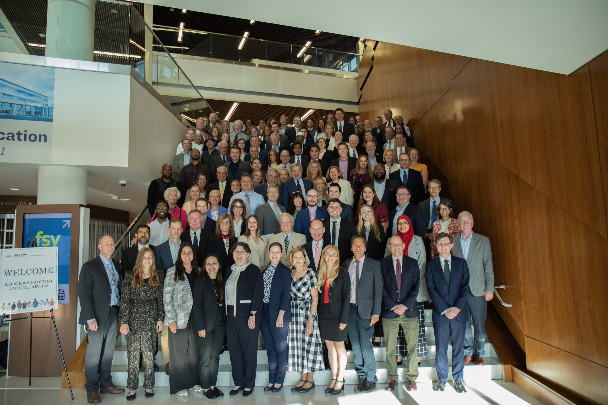


2024 RELIGIOUS FREEDOM ANNUAL REVIEW
THURS, JUNE 20 | 8:30 AM–5:30 PM
BYU CONFERENCE CENTER

